Slide 1
Struts framework
Introduction to MVC Architecture – Struts2 Framework Architecture – Core Components of Struts2 – Validations in Struts – Struts2 Tiles – Annotations – Dependency Injection and Inversion of Control – Simple Struts2 Application

Slide 2
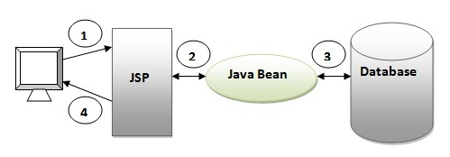
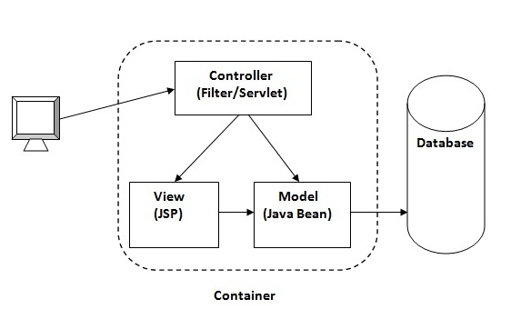
Web Application Design Models
Model 1 Architecture
Servlet and JSP are the main technologies to develop the web applications.
Problem in Servlet technology :Servlet needs to recompile if any designing code is modified. It doesn't provide separation of concern. Presentation and Business logic are mixed up.
Model 2
Model 2 is based on the MVC

Slide 3
Introduction to MVC Architecture
The Model-View-Controller (MVC) framework is an architectural/design pattern that separates an application into three main logical components Model, View, and Controller. Each architectural component is built to handle specific development aspects of an application. It isolates the business logic and presentation layer from each other. It was traditionally used for desktop graphical user interfaces (GUIs).
The main goal of this design pattern was to solve the problem of users controlling a large and complex data set by splitting a large application into specific sections that all have their own purpose

Slide 4
MVC Architecture
This framework is designed to streamline the full development cycle from building, to deploying and maintaining applications over time.
Model View Controller or MVC as it is popularly called, is a software design pattern for developing web applications
Model − The lowest level of the pattern which is responsible for maintaining data.
View − This is responsible for displaying all or a portion of the data to the user.
Controller − Software Code that controls the interactions between the Model and View.

Slide 5
Features of MVC
It provides a clear separation of business logic, Ul logic, and input logic.
It offers full control over your HTML and URLs which makes it easy to design web application architecture.
It is a powerful URL-mapping component using which we can build applications that have comprehensible and searchable URLs.
It supports Test Driven Development (TDD).

Slide 6
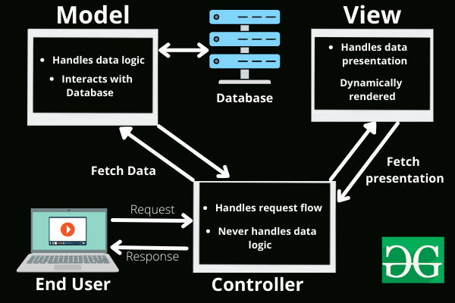
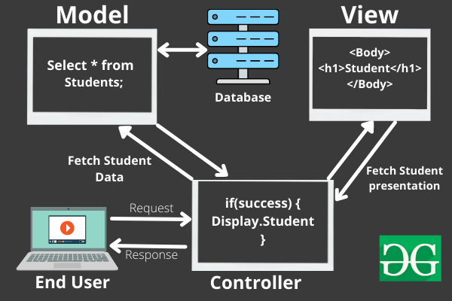
MVC Generic vs Specific

Slide 7
Struts
Struts is an open source framework that extends the Java Servlet API and employs a Model, View, Controller (MVC) architecture.
It enables you to create maintainable, extensible, and flexible web applications based on standard technologies, such as JSP pages, JavaBeans, resource bundles, and XML.
The Struts 2 framework is used to develop MVC (Model View Controller) based web applications. Struts 2 is the combination of webwork framework of opensymphony and struts 1.
The Struts 2 provides supports to POJO based actions, Validation Support, AJAX Support, Integration support to various frameworks such as Hibernate, Spring, Tiles etc, support to various result types such as Freemarker, Velocity, JSP etc.
Struts follows J2EE design patterns including MVC and JSP custom tag libraries

Slide 8
Struts – Features
The struts 2 framework is used to develop MVC-based web application. The important features of struts 2 framework are as follows:
Configurable MVC components – In struts 2 framework, we provide all the components (view components and action) information in struts.xml file. If we need to change any information, we can simply change it in the xml file.
POJO based actions – In struts 2, action class is POJO (Plain Old Java Object) i.e. a simple java class. Here, you are not forced to implement any interface or inherit any class.
AJAX support – Struts2 provides support to ajax technology. It is used to make asynchronous request i.e. it doesn't block the user. It sends only required field data to the server side not all. So it makes the performance fast.

Slide 9
Struts – Features
Integration support – We can simply integrate the struts 2 application with hibernate, spring, tiles etc. frameworks.
Various Result Types – We can use JSP, freemarker, velocity etc. technologies as the result in struts 2.
Various Tag support – Struts 2 provides various types of tags such as UI tags, Data tags, control tags etc to ease the development of struts 2 application.
Theme and Template support – Struts 2 provides three types of theme support: xhtml, simple and css_xhtml. The xhtml is default theme of struts 2. Themes and templates can be used for common look and feel.

Slide 10
Features at a glance
Struts encourages good design practices and modeling because the framework is designed with “time-proven” design patterns.
Struts is very well integrated with J2EE.
It supports many convenient features such as input validation and internationalization.
It is flexible and extensible; it is easy for the existing web applications to adapt the struts framework.
Struts provide good tag libraries.
It allows capturing input form data into JavaBean objects called Action forms.

Slide 11
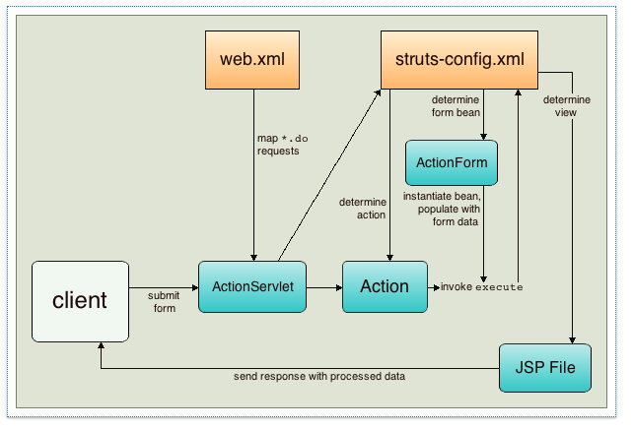
Working of Struts
The framework provides you with a controller servlet, ActionServlet, which is defined in the Struts libraries
The controller servlet uses a struts-config.xml file to map incoming requests to Struts Action objects, and instantiate any ActionForm objects associated with the action to temporarily store form data.
The Action object processes requests using its execute method, while making use of any data stored in the form bean.
Once the Action object processes a request, it stores any new data (i.e., in the form bean, or in a separate result bean), and forwards the results to the appropriate view.

Slide 12
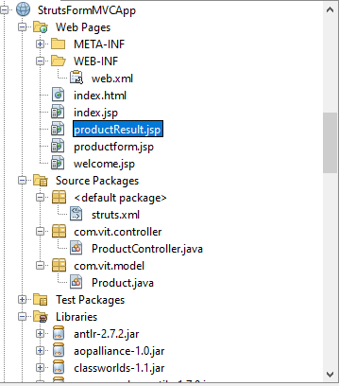

Steps to create Struts 2 Application Example
Create the directory structure
Create input page (productform.jsp)
Provide the entry of Controller in (web.xml) file
Create the Controller Class and Override execute () (ProductController.java)
Create the Action/Model class (Product.java)
Map the request with the action in (struts.xml) file and define the view components
Create view components (productResult.jsp)
Load the jar files
start server and deploy the project

Slide 13
Struts – Core Components
Interceptors
ValueStack
ActionContext
ActionInvocation
OGNL

Slide 14
Struts – Core Components Explained
Interceptors is an object that is invoked at the preprocessing and postprocessing of a request. In Struts2, interceptor is used to perform operations such as validation, exception handling, internationalization, displaying intermediate result etc.
ValueStack - A valueStack is simply a stack that contains application specific objects such as action objects and other model object.At the execution time, action is placed on the top of the stack.
ActionContext - The ActionContext is a container of objects in which action is executed. The values stored in the ActionContext are unique per thread (i.e. ThreadLocal). So we don't need to make our action thread safe.
Action Invocation - The ActionInvocation represents the execution state of an action. It holds the action and interceptors objects. The struts framework provides ActionInvocation interface to deal with ActionInvocation. It provides many methods, some of them can be used to get the instance of ValueStack, ActionProxy, ActionContext, Result etc.
The Object Graph Navigation Language (OGNL) is an expression language. It simplifies the accessibility of data stored in the ActionContext.

Slide 15
Struts – Validations
CustomValidation – We can define our own validation logic (custom validation) in struts 2 by implementing the Validateable interface in the action class. The workflow interceptor is used to get information about the error messages defined in the action class.
Bundled Validators - Struts 2 validation framework provides many built-in validators also known as bundled validators for email, string, int, double, url, date etc. So, we don't need to provide explicit logic for email, double, url etc. For providing specific validation logic, we can use regex.
Requiredstring – not null or blank
stringlength – must be of given length
email - pattern
date – within the range
int – within the range
double – within the range
url – valid string and valid url
regex – validate for the given pattern

Slide 16
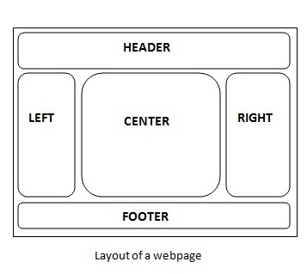
Struts – Tiles
We can customize the layout of the struts 2 application by integrating with tiles framework.
A web page can contain many parts (known as tile) such as header, left pane, right pane, body part, footer etc. In tiles framework, we manage all the tile by our Layout Manager page.
Advantages:
Customization by centralized page We can customize the layout of all the pages by single page (centralized page) only.
Code reusability A single part e.g. header or footer can be used in many pages. So it saves coding.
Easy to modify If any part (tile) is modified, we don't need to change many pages.
Easy to remove If any part (tile) of the page is removed, we don't need to remove the code from all the pages. We can remove the tile from our layout manager page.

Slide 17
Struts – Annotations
We can create struts 2 application without the configuration file struts.xml. There are two ways to create zero configuration file
By convention
By annotation
The struts 2 framework is used to develop MVC-based web application.
The steps to create zero configuration file using convention is as follows:
Create input page (optional)
Create the action class
Create view components

Slide 18
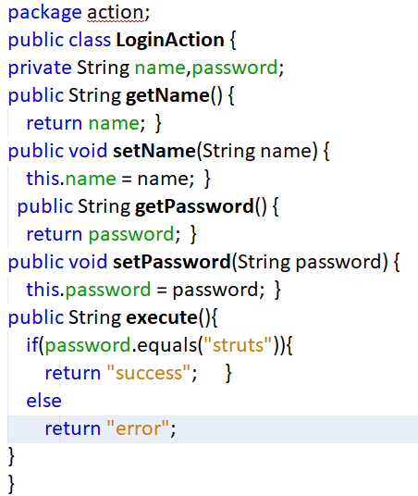
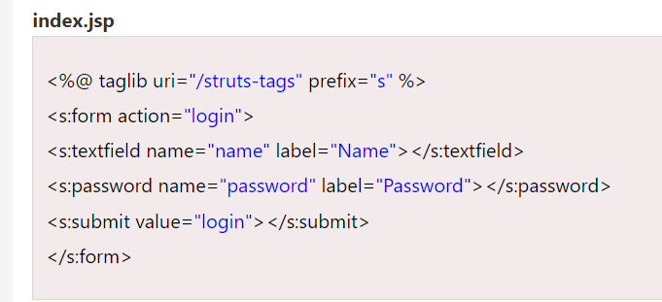
Struts – Annotation (Convention)
Example to create zero configuration file by convention. Here, 4 pages are created:
index.jsp
LoginAction.java
login-success.jsp
login-error.jsp
The action class name must be suffixed by action following the request name or it must implement the Action interface (or extend ActionSupport). Suppose that request name is login, action class name should be LoginAction if you don't want to implement Action interface.
The action class(LoginAction.java) must be located inside the action or actions or struts or struts2 package.

Slide 19
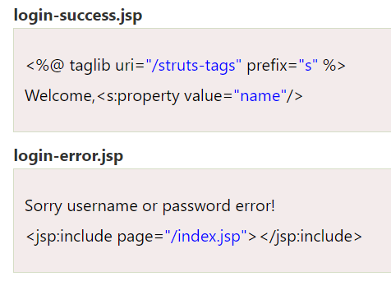
Struts - Annotation (Convention)
The view components must be located inside the WEB-INF/content folder.
The view components must be named with request name - (hyphen) string returned by action class. Suppose that request name is login and string returned by action class is success and error, file name must be login-success.jsp and login-error.jsp.

Slide 20
Struts - Annotation
For simple annotation example of struts 2, we can use 3 annotations:
1) @Action annotation is used to mark the action class.
2) @Results annotation is used to define multiple results for one action.
3) @Result annotation is used to display single result.
You need to create 4 files for struts annotated application:
index.jsp
Action class
struts.properties inside src directory
Result page
web.xml file

Slide 21
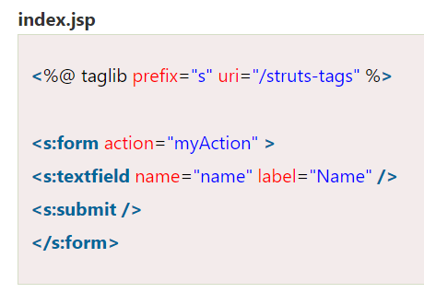
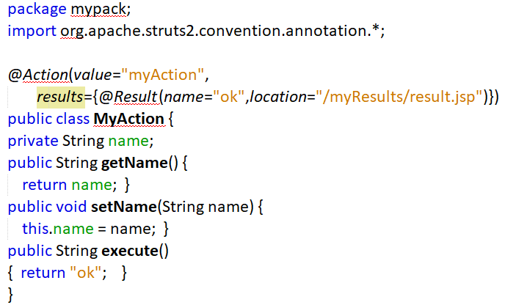
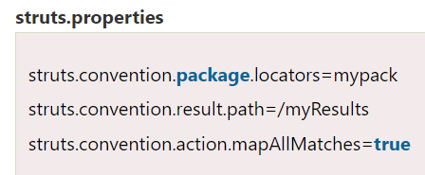
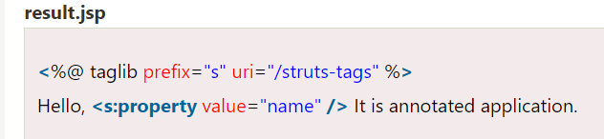
Struts

Slide 22
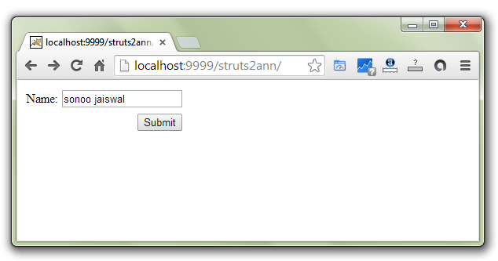
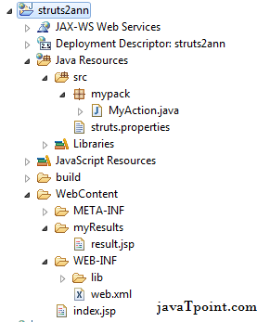
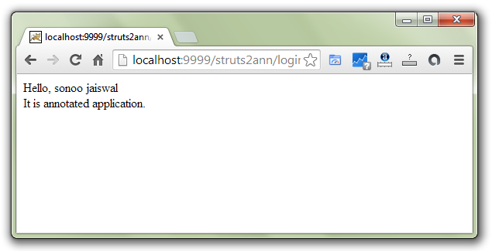
Struts - Annotation

Slide 23
Struts – References
https://www.javatutoronline.com/struts/dependency-injection/
https://www.javatpoint.com/struts-2-tutorial
https://www.baeldung.com/spring-tutorial

